Slide 1


Humic Acid Removal
Investigate humic acid performance in floc/sed model
More at Github-Humic Acid
Malini Balachandran // mvb37@cornell.edu
Kaleigh Soucy // krs258@cornell.edu
Joseph Nocua // jsn74@cornell.edu
Humic Acid | Research | Symposium Presentation Spring 2021

Slide 2
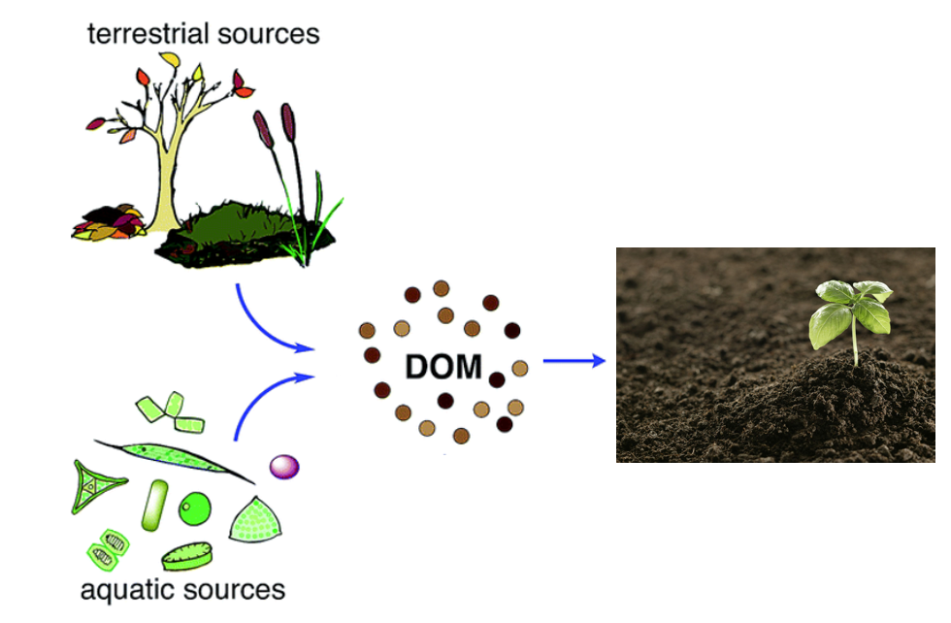
Background
Natural Organic Matter: Present in surface and groundwater
Humic Acid
1) Color, taste and odor problems
2) Increased coagulant and disinfectant doses needed for removal
3) Biological growth in distribution system
4) Increased levels of complexed heavy metals and adsorbed organic pollutants
5) Increased levels due to climate change and human activity
Reacts with chlorine during chlorination - harmful effects
Figure 1: Diagram of the formation/ life of dissolved organic material
Humic Acid | Research | Symposium Presentation Spring 2021
Notes:
-Maya
Natural Organic Matter (NOM): Present in surface and groundwater. Within Natural Organic Matter, Dissolved Organic Matter (DOM) is a part of NOM that results from plant and animal decay. Humic acid constitutes a large fraction of DOM. and although they are beneficial to plants because of their stimulation of plant growth and increase of plant disease resistance, they are not beneficial for the drinking water treatment process.
Humic acid has a negative effect on water quality by causing colour, taste and odor problems, increased coagulant and disinfectant doses needed for removal (which in turn results in increased sludge volumes and production of harmful disinfection by-products), biological growth in distribution system, and increased levels of complexed heavy metals and adsorbed organic pollutants.
react with the chlorine to produce trihalomethanes and haloacetic acids, which have carcinogenic effects

Slide 3
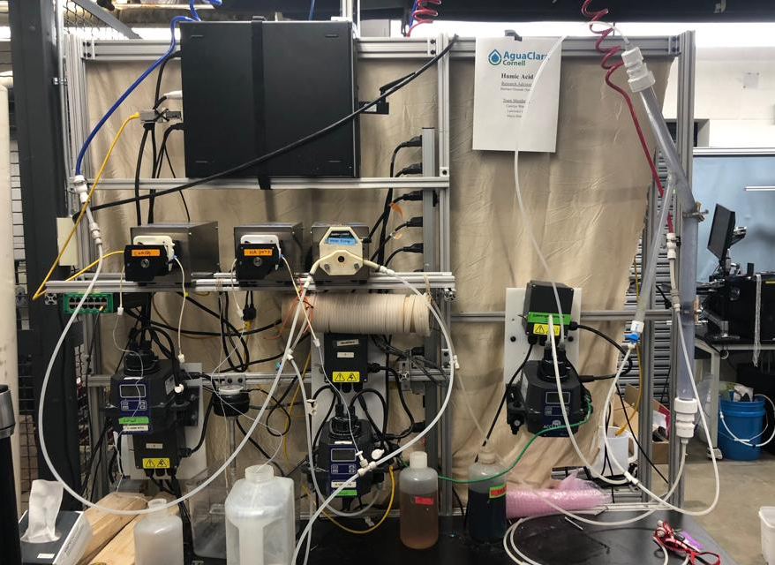
Experimental Design
Water in
Wastewater out
Recirculator
Coagulant pump
Water pump
Humic acid pump
Flocculator
Turbidimeter
Spectrophotometer
Figure 2: Image of lab set-up and experimental design
Humic Acid | Research | Symposium Presentation Spring 2021
Notes:
-Maya
Three pumps: one for coagulant, HA, and water
Water is pumped from the inlet and combined with the HA, then goes into the turbidimeter
Then combines with coagulant stream and goes into the flocculator, then into the recirculator and sedimentation tank and then the spectrophotometer
Flocs go into the tube settler, then combine with the stream out of the spectrophotomer to go to the wastewater stream out

Slide 4
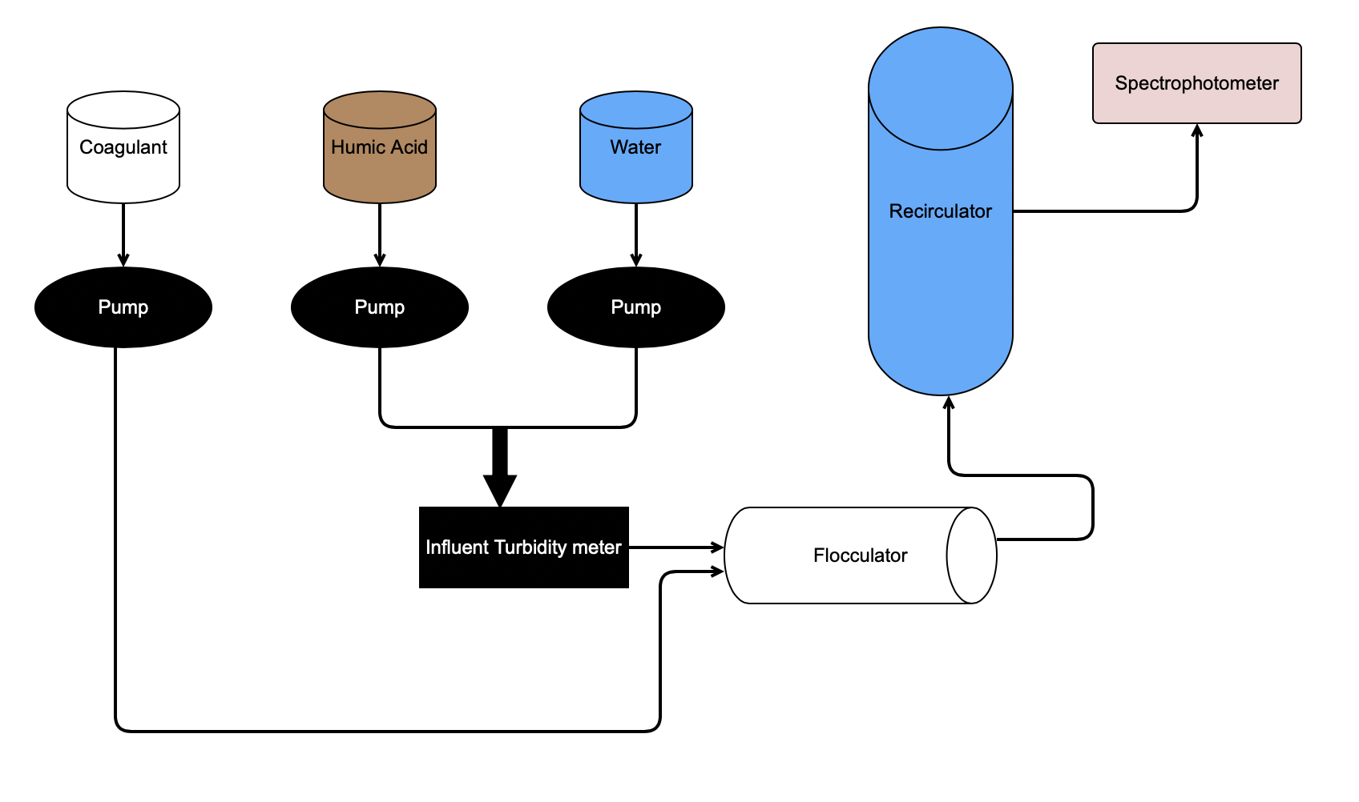
Schematic Drawing
Effluent Turbidity meter
Figure 3: Schematic drawing of the experimental set up for testing varying humic acid and coagulant concentrations
Notes:
Maya

Slide 5
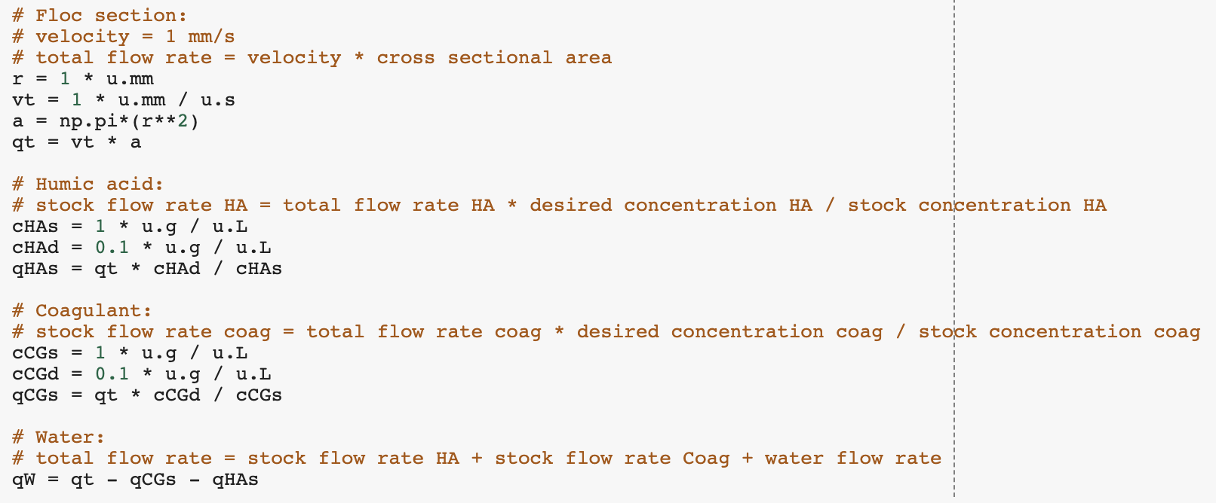
Python Code
Q_{i}C_{i}=Q_{o}C_{o}
where Q is the flow rate and C is the concentration of humic acid/coagulant
Figure 4: Image of python code used in calculating flow rates and concentrations for experimentation
Humic Acid | Research | Symposium Presentation Spring 2021
Notes:
Kaleigh

Slide 6
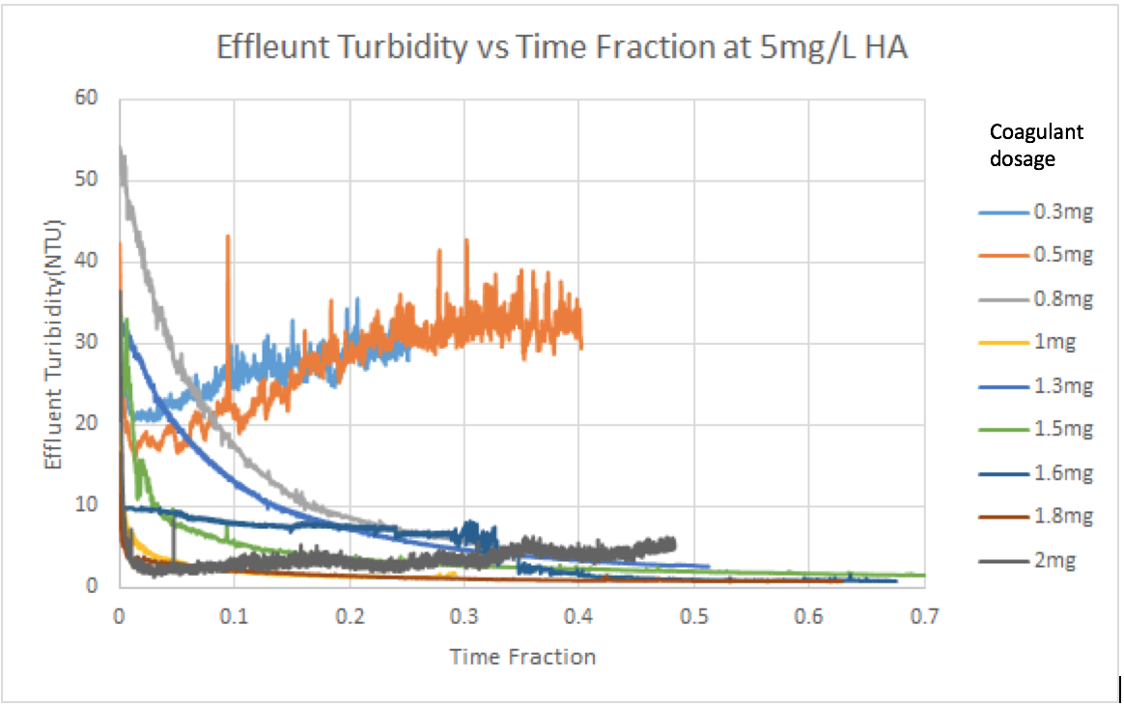
Previous Work
Fall ‘17 and Spring ‘18:
Concentration of Humic Acid (mg/L) | Optimal Coagulant Dosage (mg/L)
5 | 1.6 - 1.8
10 | 1.3
Fall ‘18:
Linear relationships between absorbance and concentration/NTU
Experiments took too long to reach steady state
Figure 5: Absorbance vs. Time Data from Fall’17/ Spring ‘18 for 5 mg/L at various coagulant dosages
Humic Acid | Research | Symposium Presentation Spring 2021
Notes:
Kaleigh
Last year, the goal was to determine the optimal coagulant dosage for two humic acid concentrations, 5 mg/L and 10mg/L.
After the experiments done with different concentrations of coagulant, the team discovered the optimal dosage for 5 mg/L is 1.6 and for 10mg/L is 1.3 mg/L. The team tried to come up with a mathematical model to calculate the optimal coagulant dosage with known concentration of Humic Acid but the problem was that even with a large change in concentration, the resulting optimal dosage change is small.

Slide 7
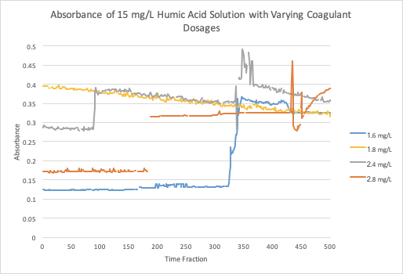
Previous Work
Fall ‘19 and Spring ‘20
Flocs form at slower speed
Small difference in absorbance with smaller and larger concentrations of coagulant
Figure 6: Absorbance vs. Time Data from Fall’19 for 15 mg/L at various coagulant dosages
Humic Acid | Research | Symposium Presentation Spring 2021
Notes:
Kaleigh
Last semester the focus was on increasing the concentration of humic acid and testing different coagulant dosages at each. The team discovered that at higher coagulant dosages around 2-3 mg/L there was very little change of absorbance recorded which indicates that there’s a limit to how much coagulant can be put in before it becomes ineffective. They were also experimenting with decreasing the amount of Koalin clay present to see its effect

Slide 8
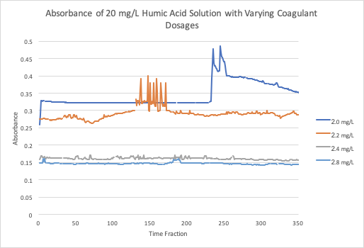
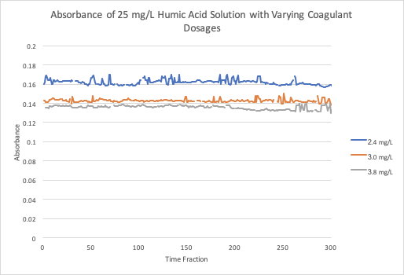
Previous Experiments
Figure 7: Absorbance vs. Time Data from Fall’19 for 20 mg/L at various coagulant dosages
Figure 8: Absorbance vs. Time Data from Fall’19 for 25 mg/L at various coagulant dosages
Humic Acid | Research | Symposium Presentation Spring 2021
Notes:
Kaleigh

Slide 9
Past Challenges
Steady state not defined
ProCoDa communicating with 4 pumps
Running out of Humic Acid influent
Removing Humic Acid without/ with small amounts of Kaolin Clay
Humic Acid | Research | Symposium Presentation Spring 2021
Notes:
Complications: Kaleigh

Slide 10
Completed Tasks and First Steps
Reviewed ProCoDA code and past literature about humic acid
Met with our mentor, Tigran Mehrabyan and gained insight about next steps for Humic Acid Removal Subteam
Get into Lab and get familiar with the experimental setup
Humic Acid | Research | Symposium Presentation Spring 2021
Notes:
for this semester so far, we’ve been analyzing past humic acid reports, procoda code and previous problems the humic acid team faced. Additionally, we’ve had the opportunity to meet with our RIDE mentor Tigran. With him, we were able to ask questions about the current problems that people are having with humic acid and how we could target our research to solve those issues. With respect to starting in person research, with the assistance of Kevin Sarmiento, we were able to see the lab space in B55 in Hoilster and noted that the very first step would be to remodel the lab experimental setup previous years and determine what we would need in terms of materials to accomplish that

Slide 11
Future Tasks
Vary Parameters and determine optimum coagulant dosage
change pH, temperature and humic acid concentration
Automate trials through the use of ProCoDA
allow trials to run without us being present
Humic Acid | Research | Symposium Presentation Spring 2021
Notes:
One of our goals for this semester are to change variables regarding the water and then see how that would affect the optimal coagulant dosage. For a starting parameter, we would like to change the pH of the water and determine if and/or how much that would change the optimum coagulant dosage. Another is to automate ProCoDA, meaning develop a code that would allow us to run trials without us being present to start and stop the runs. This would allow us to collect more data and could save time for future humic acid removal subteams.

Slide 12
Potential Problems
Understanding Experimental Setup
Troubleshooting ProCoDA code
Dealing with COVID-19 Restrictions
In order to solve the majority of these problems, the previous subteam members, and current research advisor and mentors will be used as a resource
Humic Acid | Research | Symposium Presentation Spring 2021
Notes:
When accomplishing these goals, we’re bound to have a few issues. The main problems we’ve identified will likely be the reconstruction of the experimental setup, troubleshooting procoda and dealing with the restrictions that may cause us to stop conducting our in person research. While we can’t predict the specific problems until we actually face them, we can act proactively and let our RA and mentors know that we’ll likely need their assistance in these following areas so they can be as prepared to help us as well

Slide 13
Appendix
Slides
Humic Acid| Research | Symposium Presentation Spring 2019
Notes:
From this point on, add any slides with figures that will help support your thesis. You might pull these figures from your Final Report.

Slide 14
Bibliography
Logan, B. E., Hermanowicz, S. W., & Parker,A. S. (1987). A Fundamental Model for Trickling Filter Process Design. Journal (Water Pollution Control Federation), 59(12), 1029–1042.
Matilaninen, A, Vepsalainen, M & Sillanpaa, M. (2010). Natural Organic Matter Removal by Coagulation during Drinking Water Treatment. Adv Colloid Interface Sci.
Soh, YC, Roddick, F & Van Leeuwen, J. (2008). The Impact of Alum Coagulation on the Character, Biodegradability and Disinfection By-product Formation Potential of Reservoir Natural Organic Matter (NOM) Fractions. Water Sci Technol. 58(6), 1173-9.
Kopfler, F., H. Ringhand, W. Coleman, AND J. Meier. REACTIONS OF CHLORINE IN DRINKING WATER, WITH HUMIC ACIDS AND 'IN VIVO'. U.S. Environmental Protection Agency, Washington, D.C., EPA/600/D-84/196 (NTIS PB85160737).
Du, Y. (2017). Observations and a Geometric Explanation of the Effects of Humic Acid on Flocculation.
Humic Acid| Research | Symposium Presentation Spring 2019
Notes:
-Carolyn

Slide 15
Questions
and
Recommendations
Malini Balachandran // mvb37@cornell.edu
Kaleigh Soucy // krs258@cornell.edu
Joseph Nocua // jsn74@cornell.edu
Humic Acid | Research | Symposium Presentation Spring 2021

